Slide 1
Module 4 - Variant Calling and VCF Files
Paul Bailey
BecA-IRLI Bioinformatics Workshop
11 - 15 June 2018
Notes:
Learning about variation calling
and understanding VCF format which is the file format for storing SNP call information

Slide 2

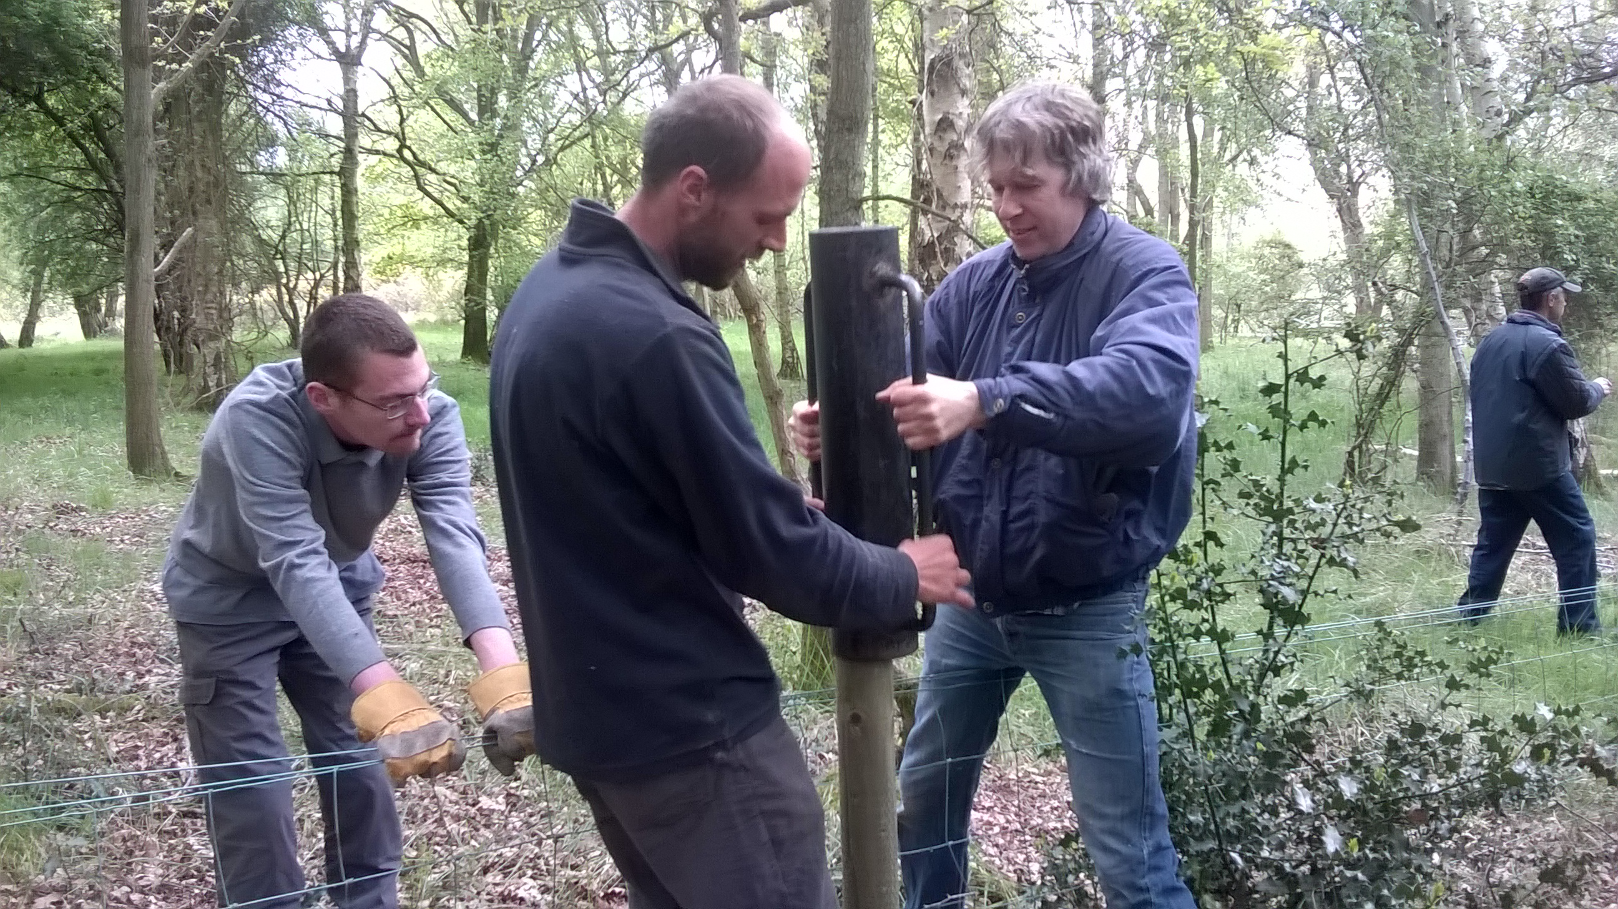
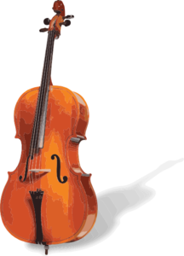
Background - my route to becoming bioinformatician
BSc Biological Sciences - University of Leicester, UK
PhD Plant Molecular Biology - seed dormancy - University of Nottingham, UK
Postdocs (x4!) - plant transcription factors of secondary metabolism
During last postdoc - MSc in Bioinformatics - University of Manchester, UK
Support Bioinformatician - John Innes Centre, Norwich, UK
Present – Bioinformatician - Earlham Institute, Norwich, UK
Outside interests! music wildlife conservation
Notes:
Your headed down a path to becoming to bioinformatician
I thought I would share my path into bioinformatics
Originally intended to study ecology at university - general biology degree at Leiceter Uni with the intention to specialize
But Molecular biology taught well, got excited by that – DNA fingerprinting man, Alec Jefferies
How did I get into bioinformatics – started doing phylogenetics with PHYLIP
Conservation – building around a species meadow to keep grazing animals in and prevent it from turning into forest

Slide 3


Variant Calling Agenda
Background – types of variation – definition of a SNP and calling methods
Building a SNP calling pipeline or workflow
Variant calling tools
Filtering SNP calls
Practical 1 - calling variants with a small wheat RNA-Seq data set from spike tissue (Illumina data 100 bp paired end reads)
Explanation of VCF format and filtering VCF files
Annotating SNPs with snpEff
Visualising bam files and SNPs in IGV
Practical 2 – Seedling RNA-Seq data sets from Arabidopsis accessions
(Illuimina data 78 bp single end reads)
Slide Acknowledgements
Jose de Vega, Earlham Institute
Dr. Christian Rausch
Ramesh Nair
Georg Haberer
Manuel Spannagl
Notes:
Make clear how much data there is
There is a huge amount of literature in variant calling, particularly humans – where do you start?
Lots and lots of material from courses available on the internet - acknowledgments

Slide 4
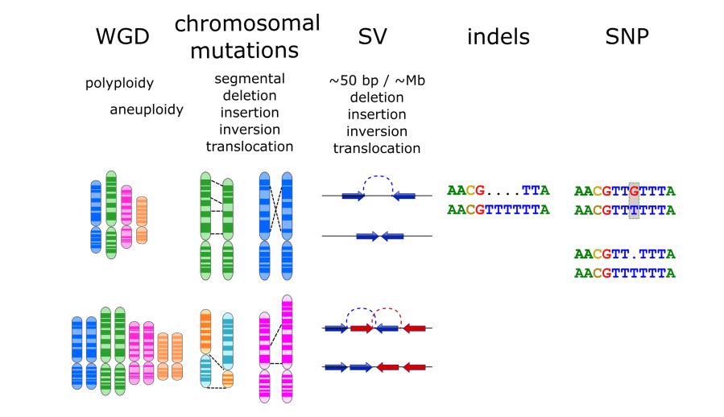
Types of genomic variation
Notes:
Illustrated here are the types of genomic variation that are present in genomes - occurs in a wide variety of different species
You can have:
→ Whole genome duplication – that’s duplication of all chromosomes
If all chrs become duplicated the genome becomes polyploid and if only one or a few chr get duplicated, that’s called aneuploidy (presence of an abnormal number of chromosomes in a cell)
→ Point to each of the four event e.g. pink is duplications of particular chr regions to other parts of the genome (see next section)
→ Structural variation – can be from 50 bp to Mb in length – can get all 4 of these events leading complicated re-arrangements (Better example here : https://en.wikipedia.org/wiki/Human_Genome_Structural_Variation
Insertion or deletion of a few nucleotides
then single nucleotide polymorphism – poly because there is more than one base between samples (s) and reference (https://en.wikipedia.org/wiki/Single-nucleotide_polymorphism – see for definition of a SNP)
FOCUSSING ON INDELS and SNPs
SNVs – single nucleotide variant - is a variation in a single nucleotide without any limitations of frequency and may arise in somatic cells e.g. in cancer; only seen in one individual
Whereas: a SNP would be expected at some freq at a given locus
All of these events have effects on phenotypic diversity of an species in some way.
Basically genomes can be a bit of a mess

Slide 5
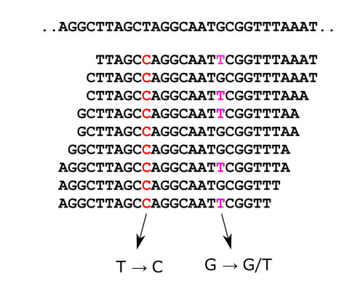
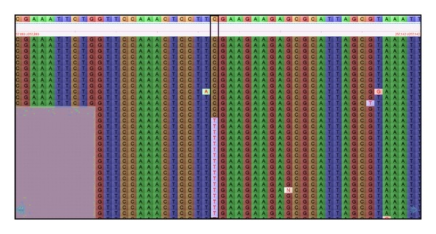
What do SNP calls look like – how can we see them?
Mismatches are potential SNPs
But:
sequencing reads can contain errors
apparent errors could be rare alleles
Genomes are complex, reads are short, so is their alignment position unique?
Notes:
Align reads to a reference sequence (already assembled genome sequence)
Read are short (although they are getting longer all the time 100 bp, 150bp common now)
Caution: genomes are complex – lots of repetitive seqs but reads are short → map position

Slide 6
Other reasons for a mismatch
Base calling error
Misalignment - local re-alignment may improve mapping
Error in reference genome sequence
Notes:
Ask them why mis-alignments occur or just tell them:
Biological replications – brought about by
Very closely related genes – brought about by recent gene tandem duplications
Transposons - brought about by replicating transposons

Slide 7
What are people using SNPs for?
For identifying SNPs associated with (human) genetic diseases and those associated with cancer
For studying associations between genetic variants and traits in samples from populations:
Genome-wide association studies (GWAS) (Module 5)
Genotyping by sequencing , association mapping
Population evolution and variation Genetics
Bulk segregant analysis (BSA) – used to identify SNPs or genetic markers associated with a mutant phenotype
e.g. genes conferring disease resistance or susceptibility
Notes:
BSA - pooled individuals with extremes in the phenotype, then call SNPs on each pool

Slide 8
So you have your sequencing data from...
Whole exome sequencing (exome capture) – gene exons region ONLY used as baits to capture DNA fragments for sequencing
Whole genome shotgun sequencing (low skim) – cost intensive – but getting cheaper...
RNA-Seq – can address multiple questions e.g.:
mRNA quantification, alternative splicing, variation
Restriction site Associated DNA Sequencing (RAD-Seq) - interrogates from 0.1 to 10% of a genome

Slide 9
Building a SNP calling Pipeline
Altmann et al (2012) Beginners Guide to SNP calling...
Notes:
First part of the pipeline is very similar to what you have already done.
For use with RNA-Seq, you need a splice aware algorithm like you’ve been using

Slide 10
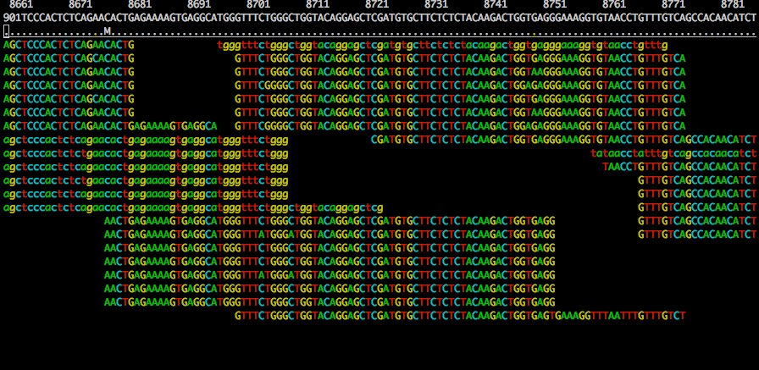
Remove duplicates
Remove potential PCR duplicates - from PCR amplification step in library prep
If multiple read pairs have identical external coordinates, only retain the pair with highest mapping quality
Duplicates manifest themselves with high read depth support - impacts variant calling
Software: SAMtools (markdup) or Picard tools (MarkDuplicates)
Human HapMap individual NA12005 - chr20:8660-8790
False SNP
Notes:
What are PCR duplicates? Could also mention optical duplicates
Why an error at the end of the seq?
I think you been through most of the pipeline but I’m not sure if you have look at read duplicates – ASK?
These appear from having to amplify small amounts of DNA.
This introduces biases in the data leading to over or underpresentation of part of the genome or the transcript

Slide 11
Variant calling methods
> 15 different algorithms
Three categories
Allele counting
Probabilistic methods, e.g. Bayesian model
to quantify statistical uncertainty
Assign priors based on observed allele frequency of multiple samples
Heuristic approach
Based on thresholds for read depth, base quality, variant allele frequency, statistical significance
SNP
variant
Ref
A
Ind1
G/G
Ind2
A/G
Nielsen R, Paul JS, Albrechtsen A, Song YS. Genotype and SNP calling from next-generation sequencing data. Nat Rev Genet. 2011 Jun;12(6):443-51. PMID: 21587300.
http://seqanswers.com/wiki/Software/list

Slide 12
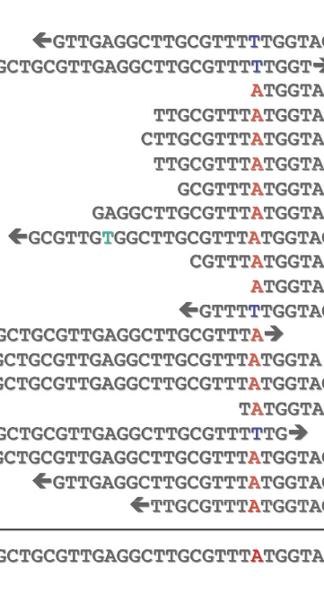
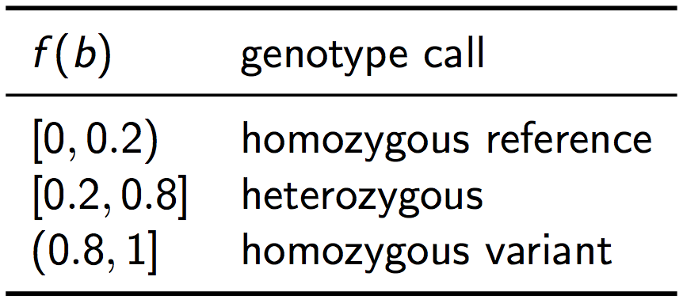
Variant Calling: Principles
Naïve approach (used in early NGS studies):
Filter base calls according to quality
Filter by frequency
Typically, a quality Filter of PHRED Q 20 was used (i.e., probability of error 1% ).
Then, the following frequency thresholds were used according to the frequency of the non-ref base, f(b):
The frequency heuristic works well if the sequencing depth is high, so that the probability of a heterozygous nucleotide falling outside of the 20% - 80% region is low.
Problems with frequency heuristic:
For low sequencing depth, leads to undercalling of heterozygous genotypes
Use of quality threshold leads to loss of information on
individual read/base qualities
Does not provide a measure of confidence in the call
In parts from: compbio.charite.de/contao/index.php/genomics.html
Notes:
Table shows the boundaries for calling a homozygous or heterozygous SNP
What is are hom and het SNPs? Explain

Slide 13
Variant Calling: Principles
Today’s Variant Callers rely on probability calculations
Use of Bayes’ Theorem:
E.g. MAQ: One of the first widely used read mappers and variant callers
Take into account a quality score for whole read alignment & quality of base at the individual position
Call the most likely genotype given observed substitutions
Reliability score can be calculated

Slide 14
Variant Calling - Popular Tools
GATK
a haplotype caller
designed for human samples
can use pooled samples
complex (2 step process)
Needs a lot of memory
FreeBayes
a haplotype caller
can use pooled samples
can use polyploid samples
SAMtools (Mpileup and Bcftools)
varScan - looks for rare SNPs in read data e.g. tumours - so quite liberal
https://bioinf.comav.upv.es/courses/sequence_analysis/snp_calling.html
Notes:
GATK and FreeBayes are haplotype-based variant detectors – they both try to realign seqs around a variant region
Haplotype calling means that the surrounding regions can used for calling a SNP rather than simply relieing on the strict alignment
And they can look around the SNPs in multiple samples to see how many other SNPs there are in that region.
Mention how they work in general terms
Try to go through their advantages and disadvantages
GATK has rounds of calling, 2nd round is the population mode looking at all samples, first round just calls SNPs on each sample
Freebayes just has the 2nd round
GATK needs more coverage than Freebayes
GATK and Freebyases only callers designed for polyploids
GATK needs lots of memory!
We will use FreeBayes for the practicals
Mention that we are combining 4 samples together and why: program takes into consideration the observed alleles freq of multiple samples
In contrast, Samtools (and varScan) which don’t have the haplotyping feature
However SNP calls could be OK with high coverage (What level is classed as high coverage?) – so Samtools could also be option if you already have it installed
Look at how much coverage is required to call its gettign lower an lower.

Slide 15
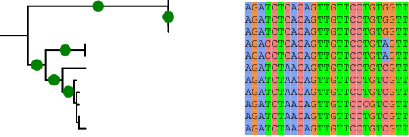
From Genome to Genomes!
Sequencing of many genomes and individuals is underway
Single genome reference multiple versions for one species
Can detect a core set of genes (unexpanded) and a non-core set (expanded)
we are now moving to
reference dependent analysis
reference independent analysis
map reads to
reference
🌾 🌾 🌾
T
G
G
🌾
🌾
🌾
C
C
A
assemble
reads
A
T
align known and novel genes
T
Notes:
In your reading you may come across papers on the pangenome of organisms
If you consider several assemblies of a species genome and you annotate them
Ref-dependant you won’t find new genes – they will either not align OR the reads corresponding to them will cause multimapping
Solution – ref-independent analysis

Slide 16
Practical 1 – small wheat RNA-Seq Data
Call variants with a small wheat RNA-Seq data set from spike tissue (Illumina data 100 bp paired end reads)
Step 1 - prepare bam files for SNP calling (remove duplicates)
Step 2 - merge bam files and add read groups
Step 3 - call SNPs with FreeBayes
Explanation of VCF format and filtering VCF files
Step 4 – filter the vcf file to obtain good calls
Step 5 - visualising SNPs in IGV
Step 6 - annotating SNPs with snpEff
Notes:
Remember to mention that the defaults are there for a reason and you don’t need to change all of them.
But you do need to understand the which options you need to change
How am I going to introduce concepts of calling SNPS with multiple samples
Restate what Practical 1 is again steps 1 - 3
Then say I will explain what the VCF format is once everyone has got saoem SNPs after step3
say what VCF format is – it’s the format used to store information on a SNP – in a similar way that the SAM format stores info on read alignment.
Then visualisation and annotation
COMMANDS
ls –alrt – useful for looking at previous files created or modified – press return several times to separate out your comds form one another. (?)
alias l='ls -alrt’
| wc –l
cd ../baileyp fullpath vs relative path - use paths when looking around the directories
pwd
top
df –h
du –ch
In commands you can use more than one space!
redirection > (depends on the program you are using (AND STDERR??) piping |
# explain comments in scripts and to comment out a block of code :<<***string_marker_for_commenting_out_code***. Finishes with ***string_marker_for_commenting_out_code***
Use of vi to edit – it’s on every machine
shell variables – use the first cmdline practical
Then introduce the markdown file – walk through the first step, then explain some command line stuff - the postits – blue OK, orange not OK
Walk through first step – first say where the data is - output with _demo, then go to next step
Also mention that they can perform a loop to process the samples
warn that the paths might not be correct; also suggest to put them in an sbatch script to form a pipeline
Afterwards, Summarise the results + conclusions. And go through the Q’s.
Lots of inline documntation

Slide 17
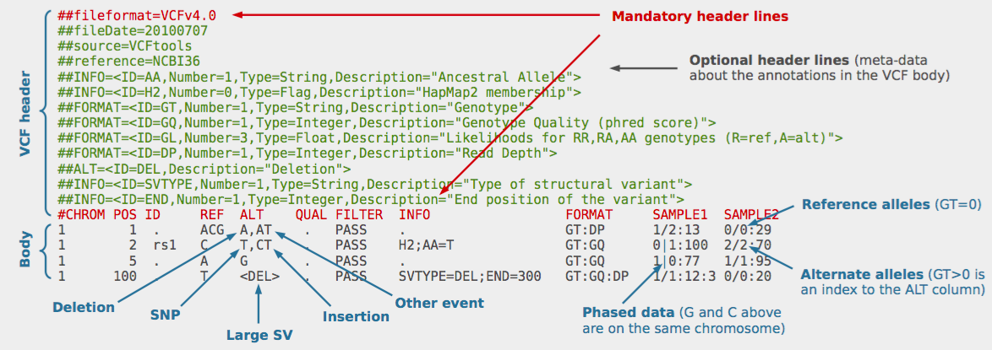
The VCF Format for stores SNP Call Information
Used for storing gene sequence variations:
SNPs
Insertions and deletions (indels)
Others: DUP, INV, CNV and yet more others
Notes:
VCF = variant calling format
Points:
Header and body
## rows define special kewords – important ones: INFO, FILTER FORMAT
# header for thre SNP table
The body has 8 main columns, then followed by columns of genotype data if present, starting with the FORMAT column
REF – reference – remember how an indel is represented – I think it comes with the adjacent base
ALT – list of alternative alleles
Many
INFO field – key=value pairs, separated by semi-colons – many are optional
FORMAT optional list of fields describing each sample
FreeBayes output from Practical4 (wheat):
Interesting INFO field definitions:
AC – this is the one that doesn’t make sense to me – it’s “allele count in genotypes for each ALT allele” – it seems to me it is counting all alleles present in the ”GT” column of the genoptype field – e.g. 0/0. 0/1
AF allele freq for each ALT allele - look like all the AC’s/GT’s
AN - T# alleles in called genoytpes - OK
DP – combined depth across samples
MQ* – mapping quality - not sure what these fields are specifally – there are several forms
NS - number of samples with data – if no SNP calling, this field is just a dot – I imagine it is because there is no coverage
SB – strand bias – expect 50:50 for:rev reads at any position. If there are many more from one strand than the other, this can indicate a difficult sequencing region and perhaps sequencing errors.
Notice that the field=value pairs are in alphabetical order which helps with manual searching
Other INFO fields:
AB – allele balance at heterozygous sites
FORMAT and genotype fields:
GT (String): Genotype, encoded as allele values separated by either of / or |. The allele values are 0 for the reference allele (what is in the REF field), 1 for the first allele listed in ALT, 2 for the second allele list
DP (Integer): Read depth at this position for this sample.
GL (Float): Genotype likelihoods comprised of comma separated floating point log10-scaled likelihoods for all possible genotypes given the set of alleles defined in the REF and ALT fields.
The other fields are not defined in the Formal format spec but they are defined in the header:
- so the
RO – the 5th SNP from Pr1 raw has an issue with the RO field

Slide 18
Filtering SNPs
Objective: separate genuine variants from sequencing errors or bioinformatics artefacts
Can be done during and/or after variant calling
Commonly used filters:
quality score
min/max number of reads at variant location (coverage depth)
number/fraction of reads with alternate allele
read mapping quality
base quality of the alternate alleles
secondary alignment filter
Filtering depends on whether or not flags are actually present in VCF file
example: PV4 field in VCF output is required for strand bias filtering but Freebayes does not output this
Variety of packages available for filtering
samtools, vcftools), bcftools (Samtools), SnpSift
You can also write your own code for filtering with awk commands
Notes:
Guidelines parameters are in the tutorial file
Point out –relatedness flag.

Slide 19
Practical 5 – Filtering Results
% of non-duplicate reads: Chinese Spring ~98 %
Azhurnaya ~49 %
Number of SNPs across the 4 samples = 12,953
Filter: minDP 6, no indels = 11,209
Filter : minDP 6, no indels, minQ = 3,641
Filter : minDP 6, no indels, minQ , max-m = 1,090
Out.TsTvSummary
out.TsTv.count
MODEL COUNT
AC 91
AG 358
AT 68
CG 110
CT 365
GT 97
Ts 723
Tv 366
Ts/Tv = 1.98
ALT_ALLELE_COUNT N_Ts N_Tv Ts/Tv
0 9 13 0.692308
1 17 12 1.41667
2 175 77 2.27273
3 36 26 1.38462
4 442 207 2.13527
5 6 5 1.2
6 17 11 1.54545
7 8 5 1.6
Notes:
Once they have called SNPs, go through the VCF format slide
Then show them their file:
flags again
empty genotype fields
Adding things up
A strange result: look at chr2B 371513 - its passed but there is no ALT allele in any sample
Maybe show the TILLING file
Then show next slide: filtering
Then get them to do the filtering...
Then show this slide
Go through Ts/Tv = 1.98
Explain the questions in the practical
Then look at the filtered file
Point out that reads are not normalised so you can also see diff gene expression - might be reflecting changes in expression of particular genes between the samples
Man vcftools
snpEff: stop_gained = 3; missense = 197 – for Practical 4
Ask Ricardo if Azhurnaya is homozygous – I think it is

Slide 20
The Number of Possible Transitions and Transversions
... therefore,
expected rate of transversions, β:
β = 2α′ ...
transversions (T_{v} or β )
(less likely in typical data)
A
C
transitions (T_{s} or α′)
(more likely in typical data)
From this diagram,
expected rate of transitions, α′:
α′ = 0.5β ...
G
T
mutation rate
... but in typical data,
observed rates are:
α′ > β
purines
pyrimidines
mutation rate
mutation rate

Slide 21
Practical 5 – Arabidopsis Accessions
Call variants with Seedling RNA-Seq data sets from two Arabidopsis accessions
(Illumina data 78 bp single end reads)
Step 1 – index reference with STAR
Step 2 – prepare reads for aligning to the reference
Step 3 – align reads
Step 4 – remove duplicate reads
Step 5 - merge bam files and add read groups
Step 6 - call SNPs with FreeBayes
Step 7 – filter the vcf file to obtain good calls
Step 8 - annotate SNPs with snpEff
https://www.ensembl.org/info/genome/variation/predicted_data.html#consequences
Notes:
Tried to prepare a real example to give you an idea of all the steps from raw read data to annotating SNPs with their consequences for the protein seq, if any.
Introduce the paper: key features – abstract and Fig2

Slide 22
Practical 2 - Results
% of non-duplicate reads: Columbia (Col_0) 49%
Landsberge (Ler_0) 51%
Number of SNPs across the 2 samples plus filtering:
Filter : minDP 6, no indels, minQ , max-m = 2,622
snpEff effects: stop_gained = 3
missense = 663
Notes:
Rmdup results
Html summary file
After filtering, kept 1090 out of a possible 10171 Sites
Go through the annotation bit of the INFO line, starts at ANN
663 missenses; 2 stop codon

